Slide 1
Learning Objectives & Outcomes
Objective:
To understand the concept of Formal Language, Operations and examples of formal languages.
Outcome:
Student will understand the
  Formal Language
  Operation on formal language

Slide 2
Languages
L is a said to be a language over alphabet ∑, only if L ⊆ ∑*
  ➔ this is because ∑* is the set of all strings (of all possible length including 0) over the given alphabet ∑
Examples:
  Let L be the language of all strings consisting of n 0’s followed by n 1’s:
  L = {ε,01,0011,000111,…}
  Let L be the language of all strings of with equal number of 0’s and 1’s:
  L = {ε,01,10,0011,1100,0101,1010,1001,…}
Definition: Ø denotes the Empty language
Let L = {ε}; Is L=Ø?
NO
Notes:
Cpt S 317: Spring 2009
School of EECS, WSU

Slide 3
Language:
A language is a collection of appropriate string. A language which is formed over Σ can be Finite or Infinite.
Example: 1
L1 = {Set of string of length 2}
= {aa, bb, ba, bb} Finite Language
Example: 2
L2 = {Set of all strings starts with 'a'}
= {a, aa, aaa, abb, abbb, ababb} Infinite Language

Slide 4
Finite Automata
Some Applications
  Software for designing and checking the behavior of digital circuits
  Lexical analyzer of a typical compiler
  Software for scanning large bodies of text (e.g., web pages) for pattern finding
  Software for verifying systems of all types that have a finite number of states (e.g., stock market transaction, communication/network protocol)
Notes:
Cpt S 317: Spring 2009
School of EECS, WSU

Slide 5
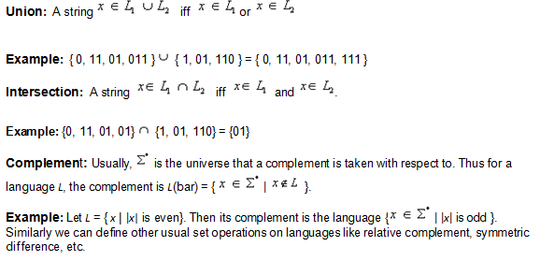
Set operations on languages :

Slide 6
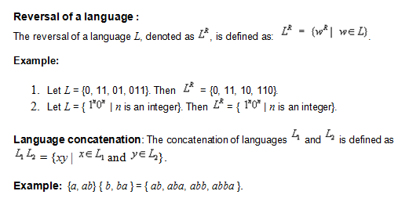

Slide 7
Example of Formal Language:
A language is a collection of appropriate string. A language which is formed over Σ can be Finite or Infinite.
Example: 1
L1 = {Set of string of length 2}
= {aa, bb, ba, bb} Finite Language
Example 2 :
Example of Finite Language: L1 = { set of string of 2 } L1 = { xy, yx, xx, yy }

Slide 8
Example: 3
L2 = {Set of all strings starts with 'a'}
= {a, aa, aaa, abb, abbb, ababb} Infinite Language
Example 4 :
Example of Infinite Language: L1 = { set of all strings starts with 'b' } L1 = { babb, baa, ba, bbb, baab, ....... }

Slide 9
Summary
Operations on Formal language
Alphabets
strings
languages
Notes:
Cpt S 317: Spring 2009
School of EECS, WSU

Slide 10
FAQ :
1. Construct the powerset for the following sets.
{a, b}
{0, 1}∪{1, 2}
{z}
{0, 1, 2, 3, 4}∩{1, 3, 5, a}
{0, 1, 2, 3}−{1, 3, 5, a}
∅ (the empty set)
2. Prove that 12 +22+32+……+ n2= ∑n2 = (n(n+1)(2n+1))/6.

